Slide 1
CEIS114 FINAL PROJECT
Multiple Traffic Light Controller with Crosswalk and An Emergency Buzzer with a Smart Sensor
Monicqua Willis

Slide 2
Introduction
Building and programming the two-way traffic light controller with a pedestrian crossing and an emergency signal.
Building of the traffic lights by a design that has one set of traffic lights that is continuously active in one direction of the major street and always red traffic light on the minor street which has less traffic flow.
Integrated a motion detector that will activate the minor street traffic light when there is a vehicle detected. Added a push button to activate the Emergency signal.

Slide 3
Project Preparation

Slide 4
CEIS 114
Module 2
Project Plan for IoT Traffic Controller
Monicqua Willis

Slide 5
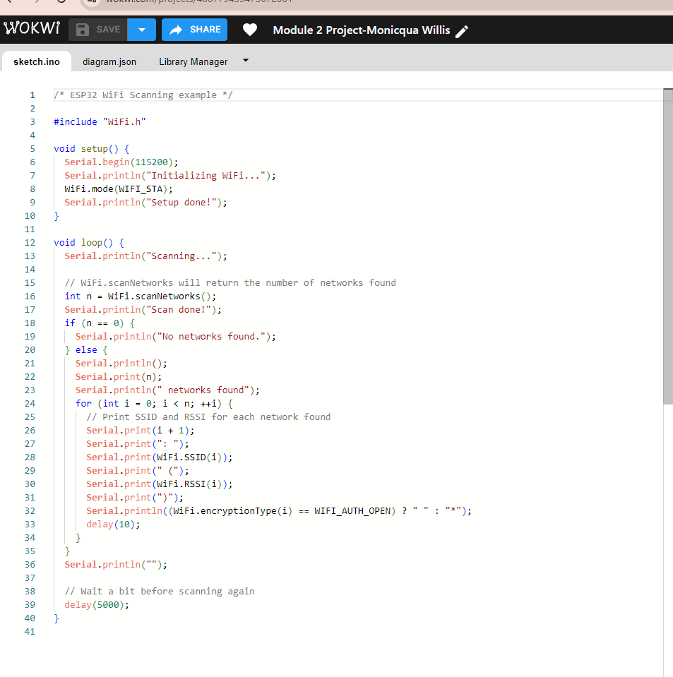
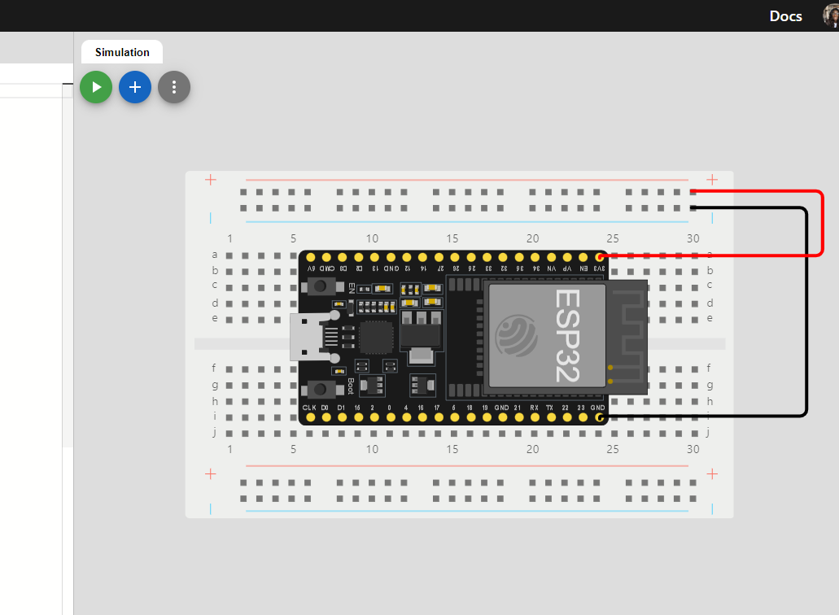
ESP32 (Screenshot)
Microcontroller mounted and powered ON

Slide 6
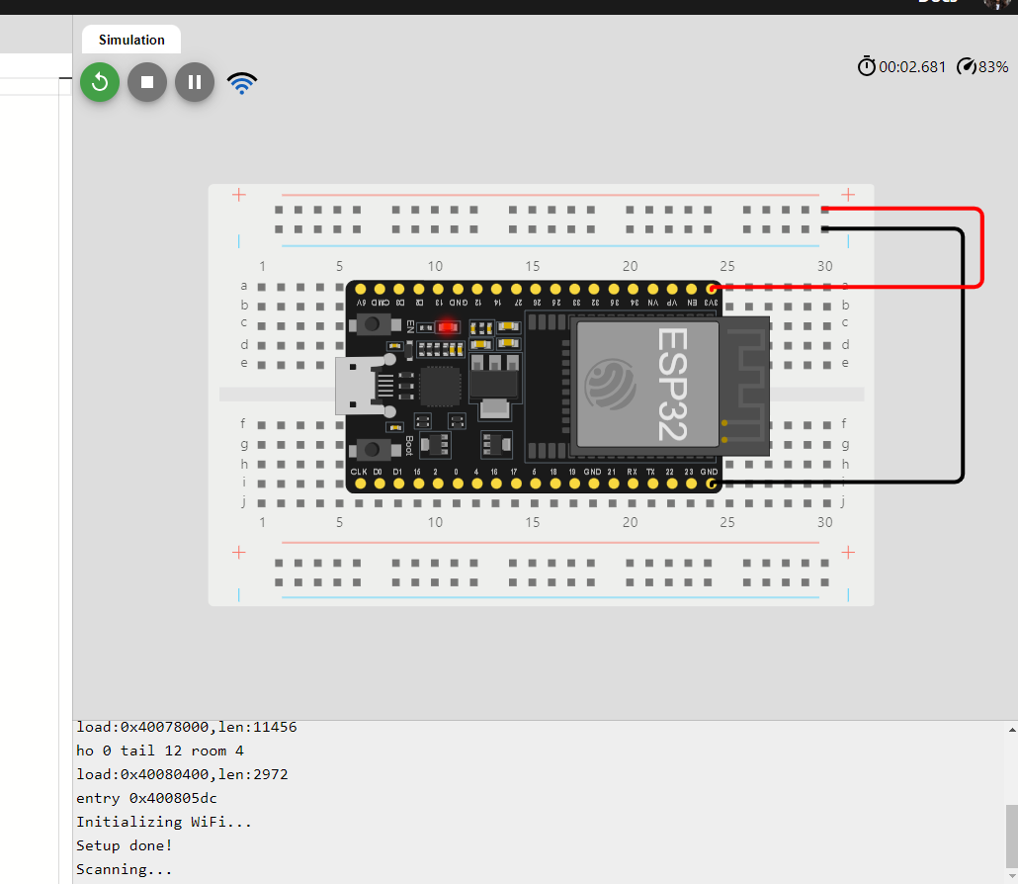
ESP32 WiFi Scan
Screenshot of Serial Monitor showing the available networks

Slide 7
Creating a Traffic Controller

Slide 8
CEIS 114
Module 3
Creating the Traffic Controller
Monicqua Willis

Slide 9
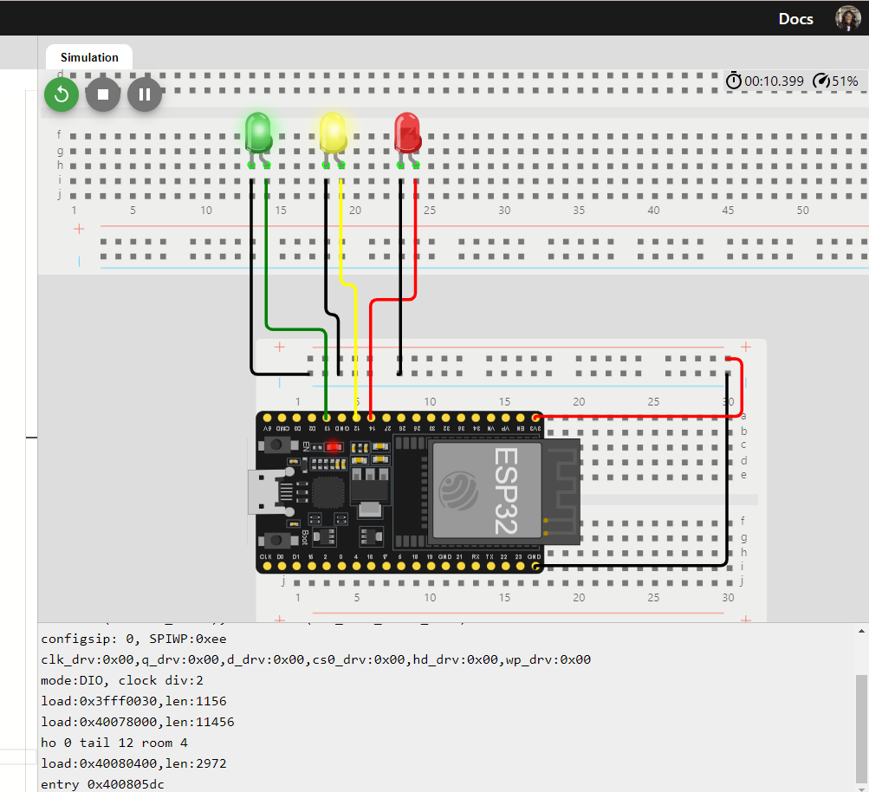
Picture of circuit with working LEDs
ESP 32 Board
Colored LEDs: Red, Yellow and Green
Wires
Breadboard

Slide 10
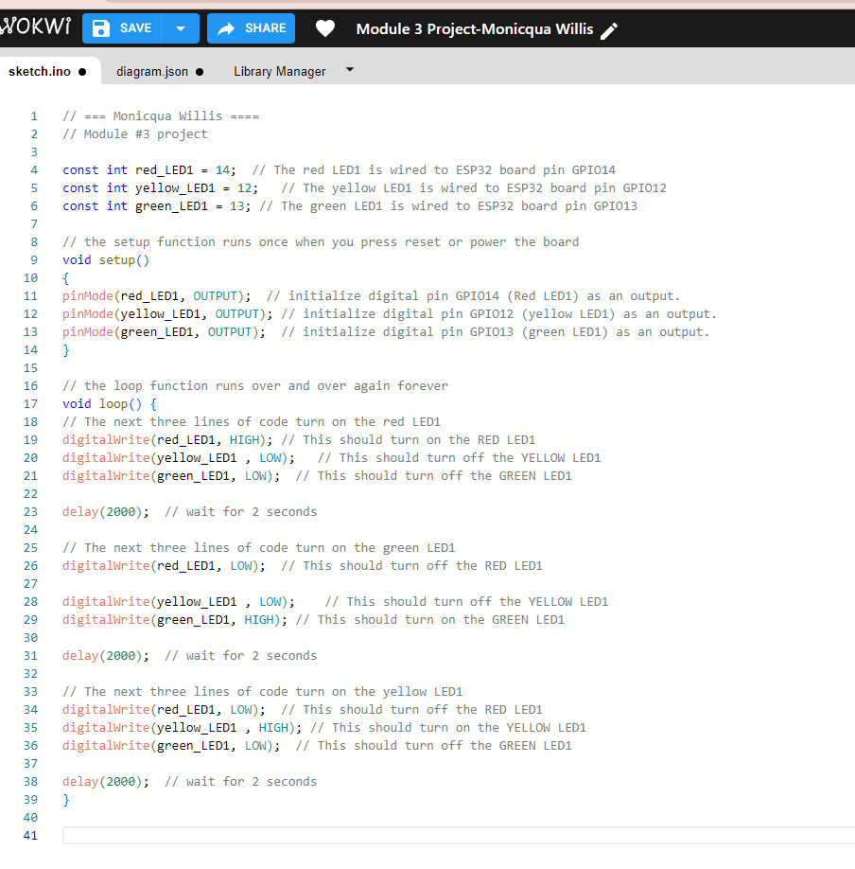
Screenshot of code in the Code Editor
Screenshot of code in the Wokwi Code Editor showing your name in the comment

Slide 11
Creating Multiple Traffic Lights

Slide 12
CEIS 114
Module 4
Creating a Multiple Traffic Light Controller
Monicqua Willis
CEIS114

Slide 13
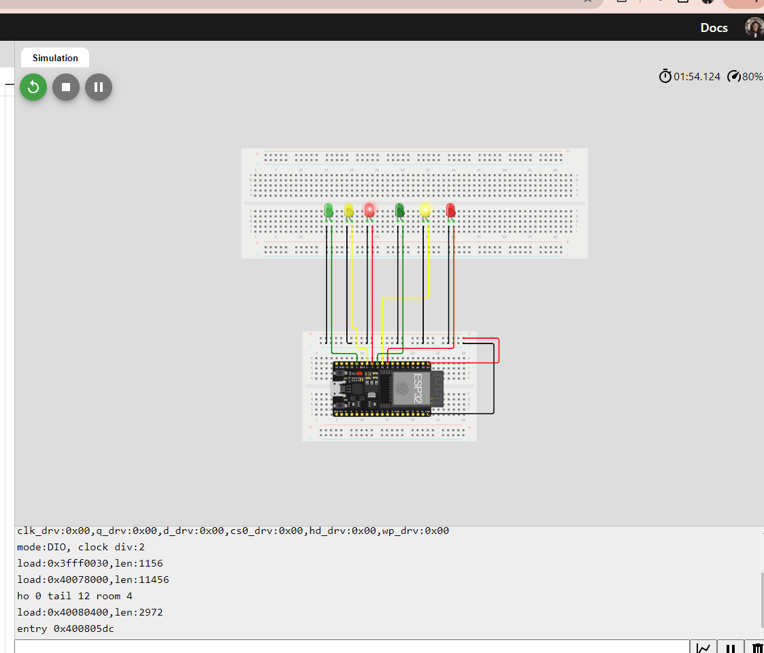
Picture of circuit with working LEDs
ESP 32 Board
Colored LEDs: Red, Yellow and Green (two sets)
Wires
Breadboard

Slide 14
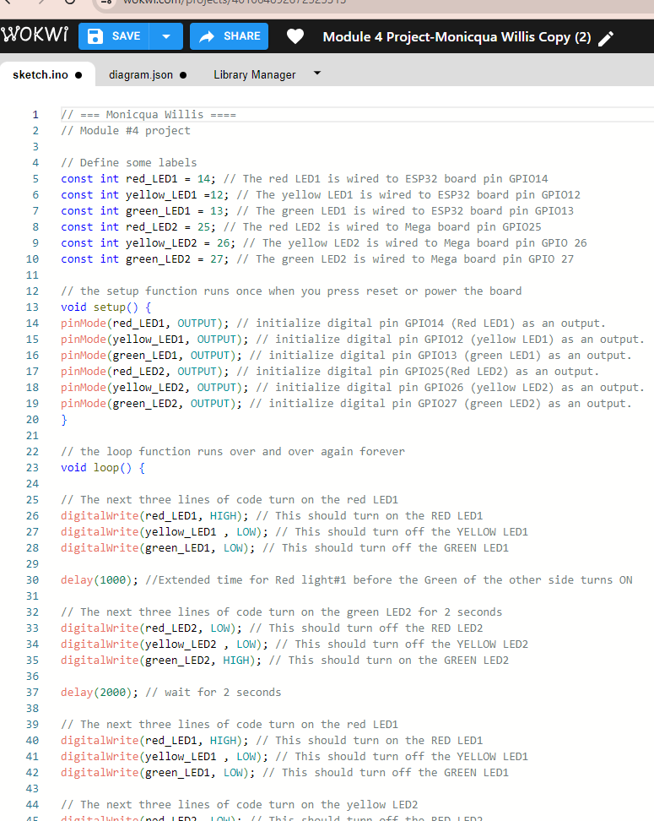
Screenshot of code in Wokwi
Screenshot of code Wokwi Code Editor showing your name in the comment

Slide 15
Creating a Multiple Traffic Light Controller with a Crosswalk and an Emergency Buzzer

Slide 16
CEIS 114
Module 5
Creating a Multiple Traffic Light Controller with a Cross Walk
Monicqua Willis

Slide 17
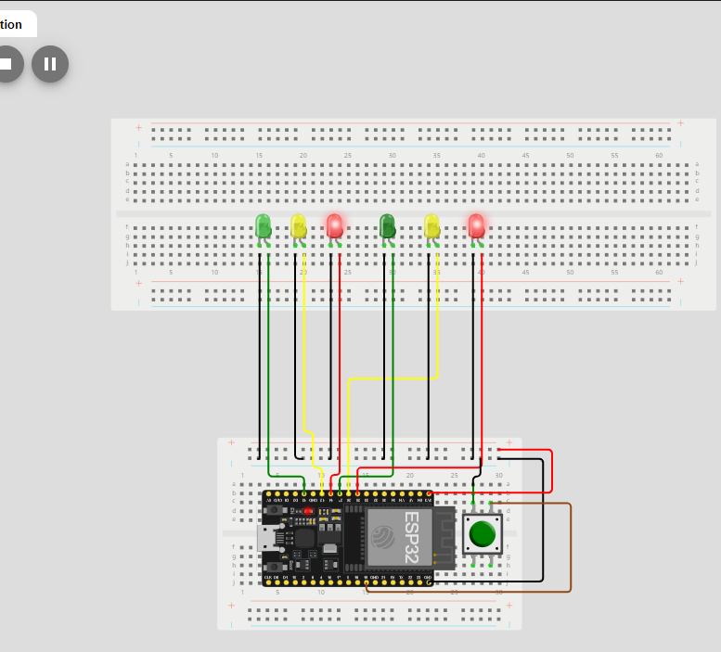
Screenshot of circuit with working LEDs
ESP 32 Board
Colored LEDs: Red, Yellow and Green (two sets)
220 Ohm Resistors (optional)
Push Button
Wires
Breadboard

Slide 18
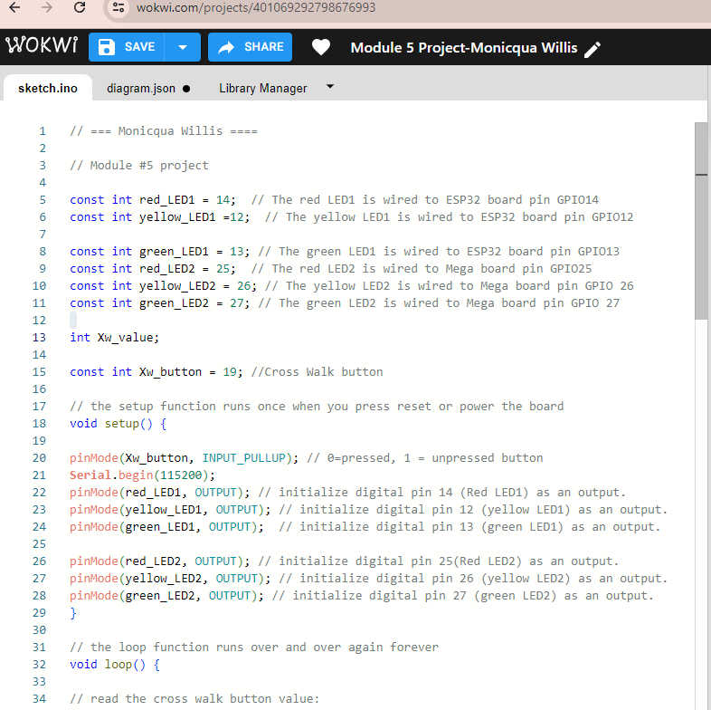
Screenshot of code in Wokwi
Screenshot of code in Wokwi Code Editor showing your name in the comment

Slide 19
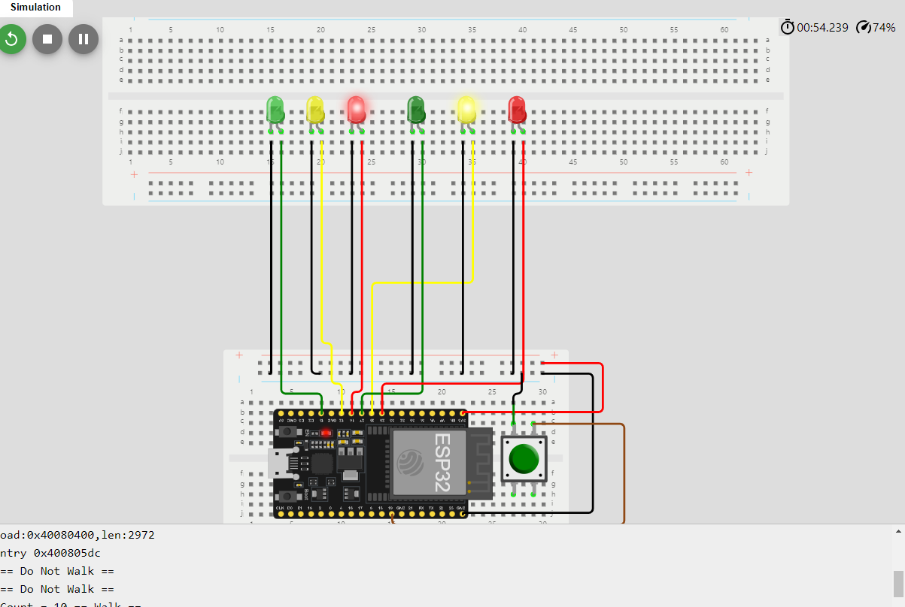
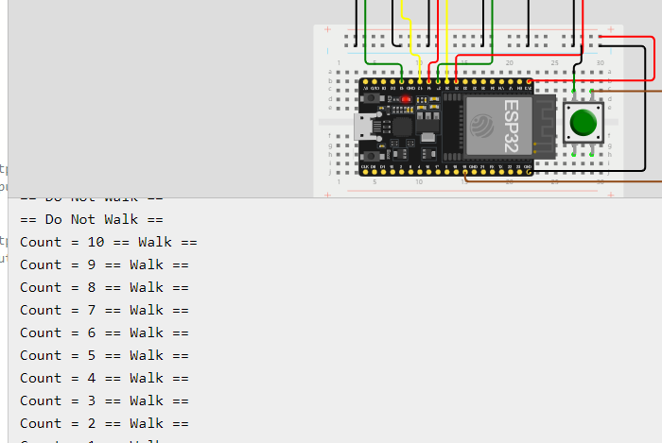
Screenshot of Serial Monitor in Wokwi
Screenshot of output in Serial Monitor

Slide 20
CEIS 114
Module 6
Creating a Multiple Traffic Light Controller with a Cross Walk and an Emergency Buzzer
Monicqua Willis

Slide 21
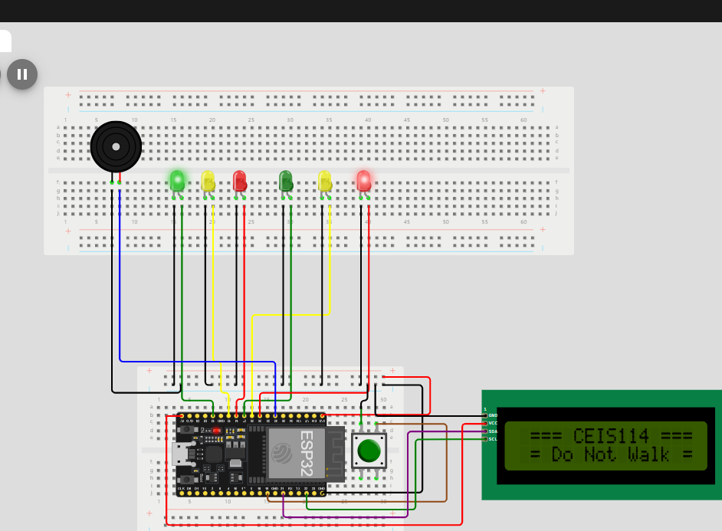
Picture of circuit with working LEDs and LCD display
ESP 32 Board
Colored LEDs: Red, Yellow and Green (two sets)
220 Ohm Resistors (optional)
Push Button
LCD Unit with Message Display
Wires
Breadboard

Slide 22
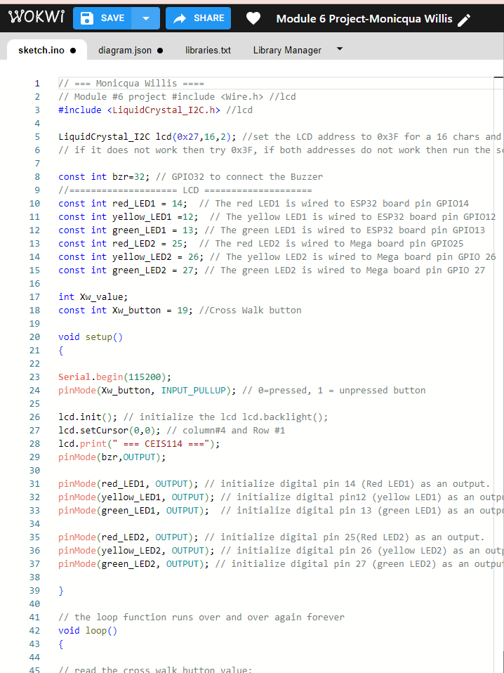
Screenshot of code in Code Editor
Screenshot of code in Code Editor showing your name in the comment

Slide 23
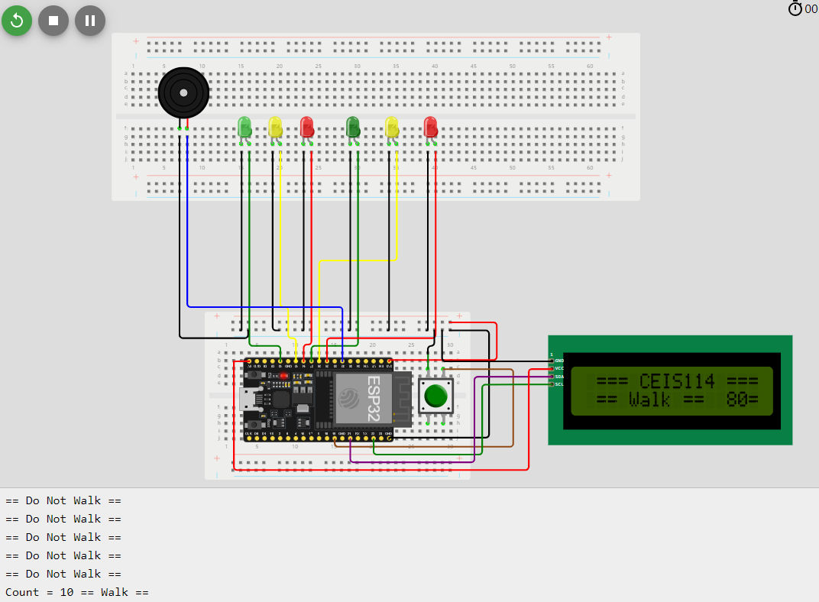
Screenshot of Serial Monitor
Screenshot of output in Serial Monitor

Slide 24
Challenges
Issues faced with incorrect wire colors.
Incorrectly placing the pin on the ESP32
Issue with the serial monitor not displaying countdown for crosswalk due to not holding the push button correctly
Did not properly align wires on bread board, pins to the ESP32.

Slide 25
Career Skills
Hardware Knowledge
Automation
Security Awareness
Understanding of the IOT
Networking and Connectivity ability

Slide 26
Conclusion
The growth in connected devices, each item in the IOT system communicates packets of data that require reliable connectivity, storage, and security.
These projects will help us with challenges such as monitoring, managing, and securing large volumes of data.

