Slide 1
CEIS101
Module 3
Inventory of Parts, Circuit Building, and Displaying Messages

Slide 2
Rubric
Activity | Requirement(s) | Points
Inventory of IoT Tech Core Kit | Picture of entire IoT kit | 5
Organization of components | Picture of required organization of components for course project | 15
Set up circuit | Picture of complete circuit with red LED on | 10
Run code | Screenshot of Serial Monitor showing your name and the messages that the LED is on/off | 10

Slide 3
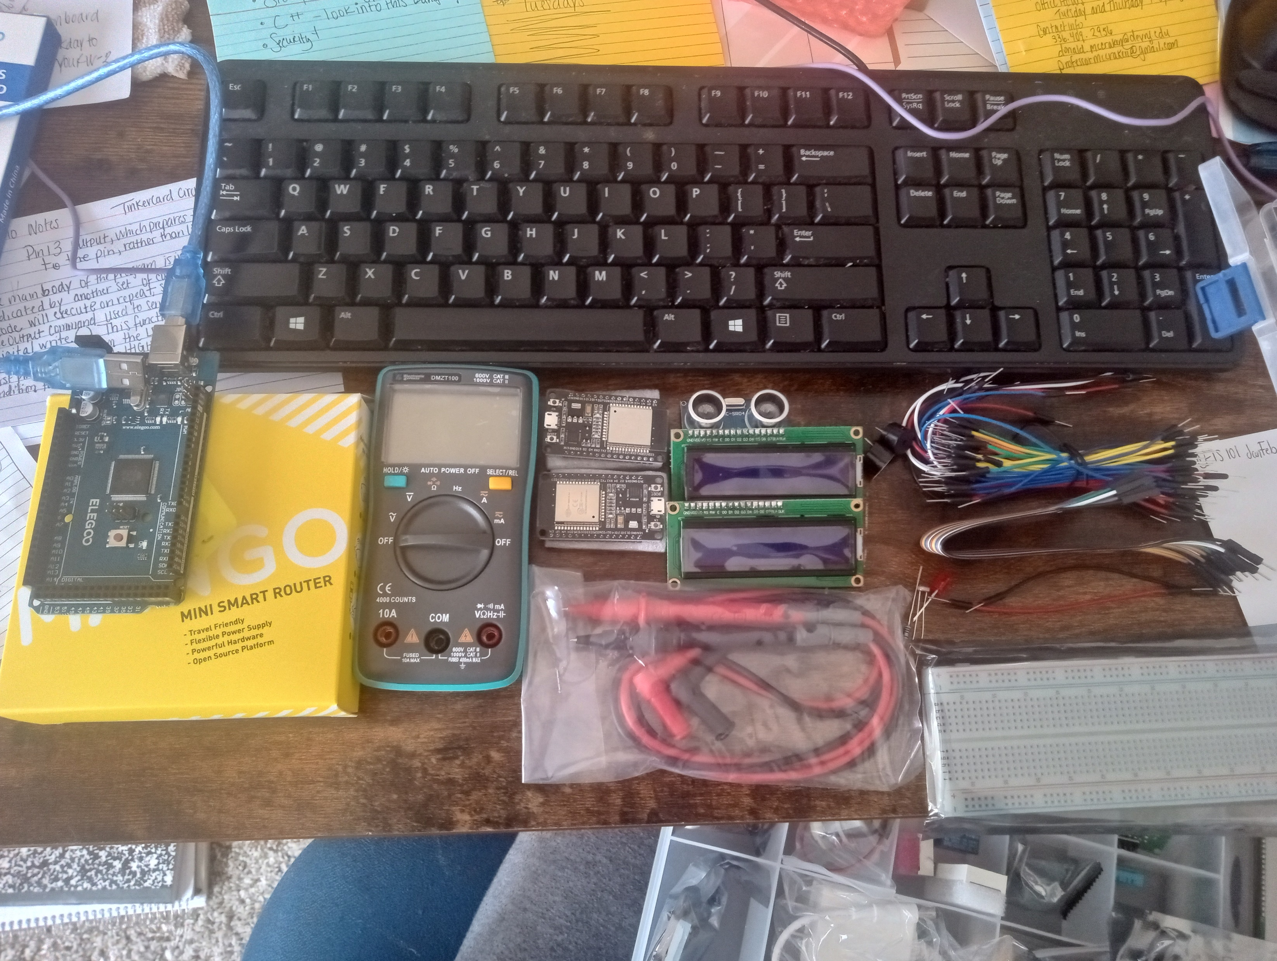
Inventory of IoT Kit (picture)
UCTRONICS Kit
ESP32 (2)
LCD Modules (2)
Breadboards (3)
Mini Router
Patch Cable
Digital Multi Meter
USB to Micro USB (2)

Slide 4
Organization of Project Components (picture)
Arduino Mega 2560
Breadboard
Resistor 10kΩ
LEDs
Ultrasonic Sensor
Active Buzzer
Photoresistor
Wires
USB Type B cable

Slide 5
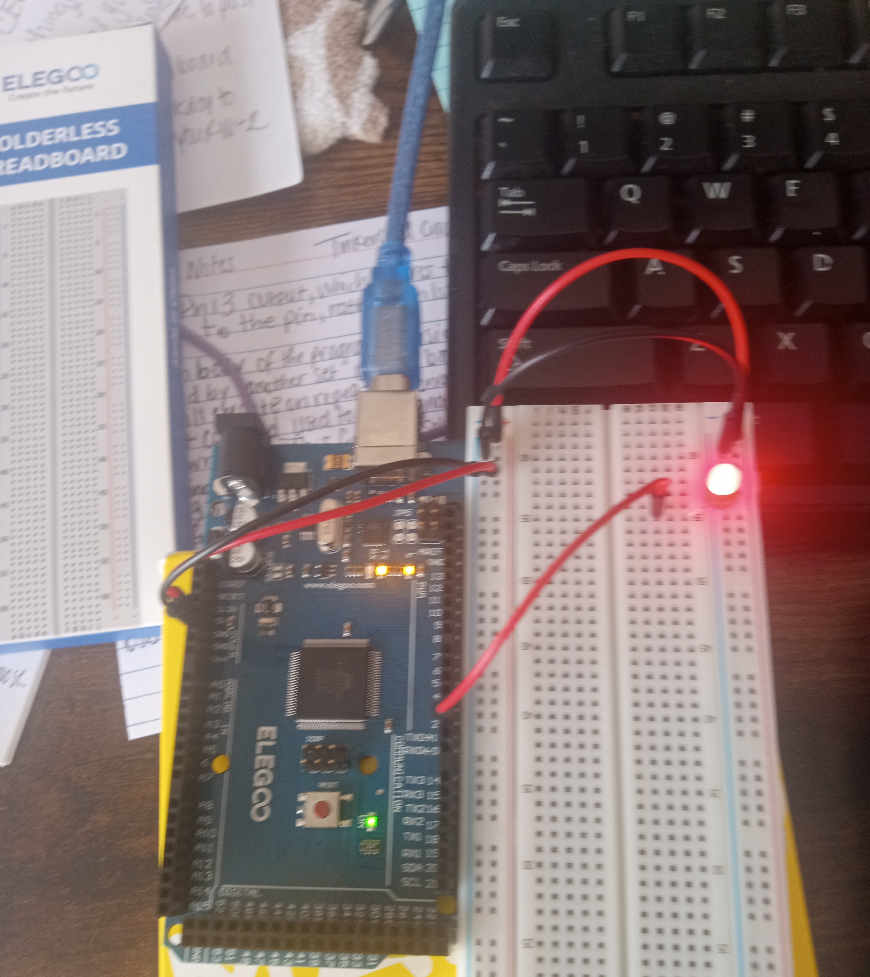
Circuit with red LED on (picture)

Slide 6
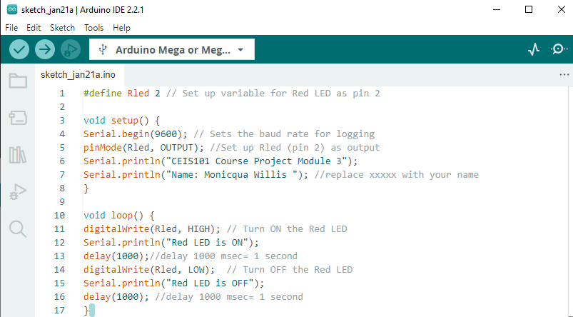
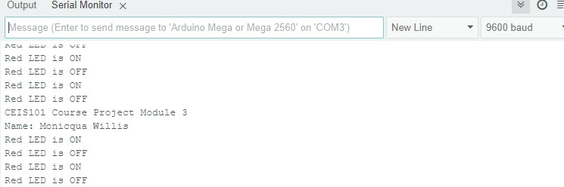
Serial Monitor (screenshot)

