Slide 1

PHYS204
PROJECT
Monicqua Willis

Slide 2
INTRODUCTION
This project is based on the scientific method and is divided into six parts.
It covers precision, free-fall motion, energy conservation, rotational motion, and hall effect.

Slide 3
Materials list
The materials list Is a vital component of any formal lab report. It clearly describes exactly what will be used to conduct the experiments.

Slide 4
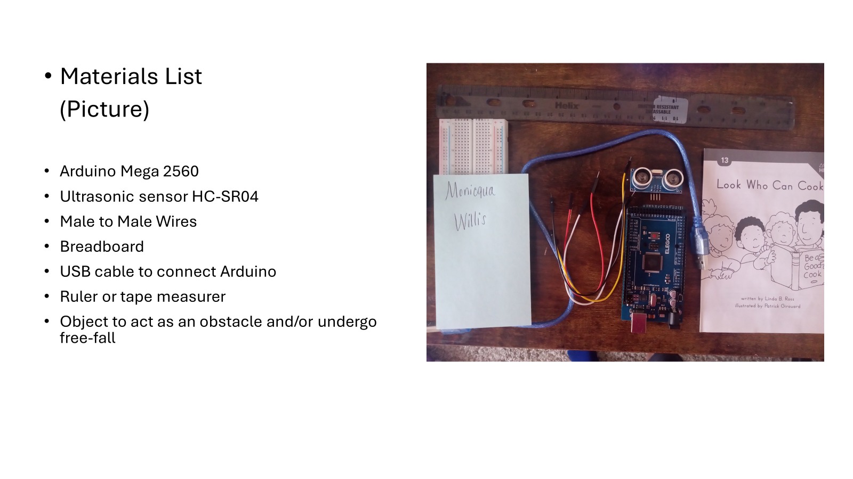

Slide 5
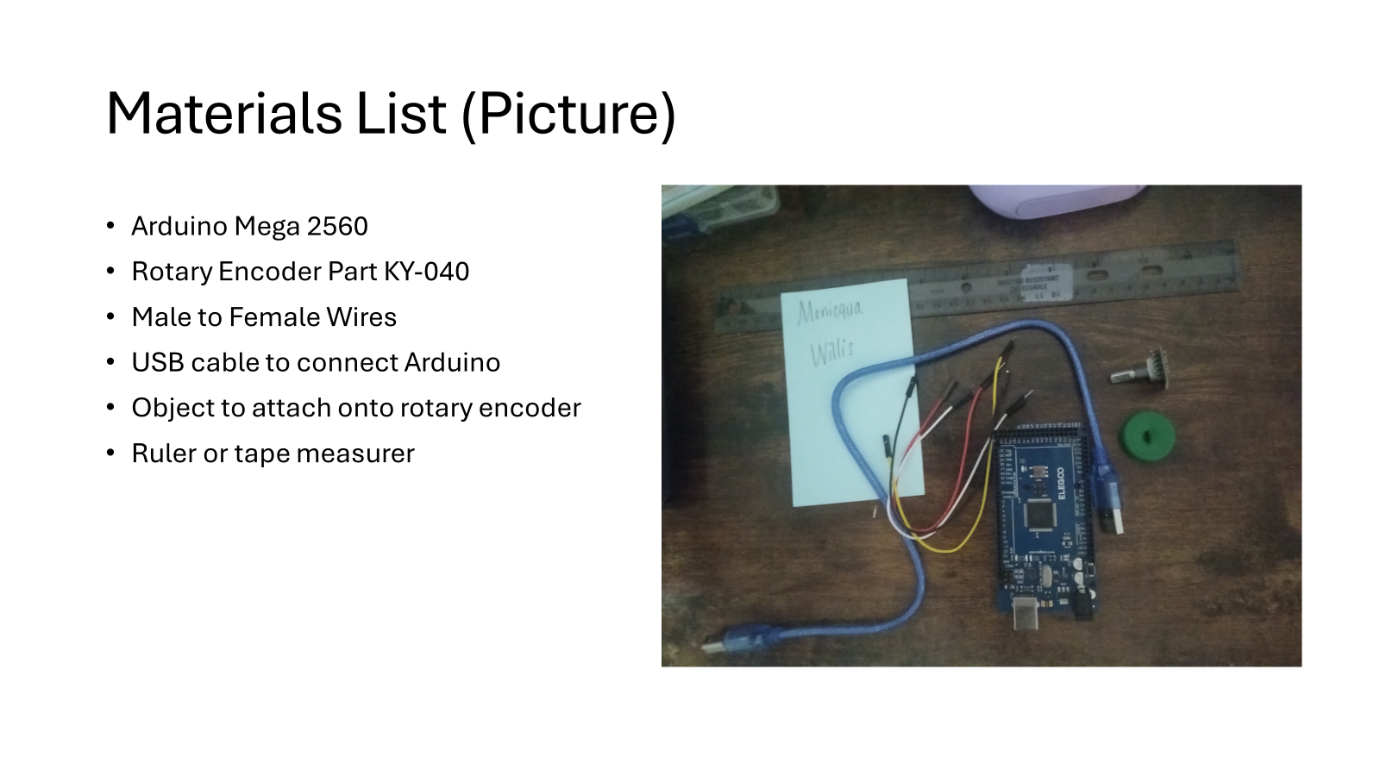

Slide 6
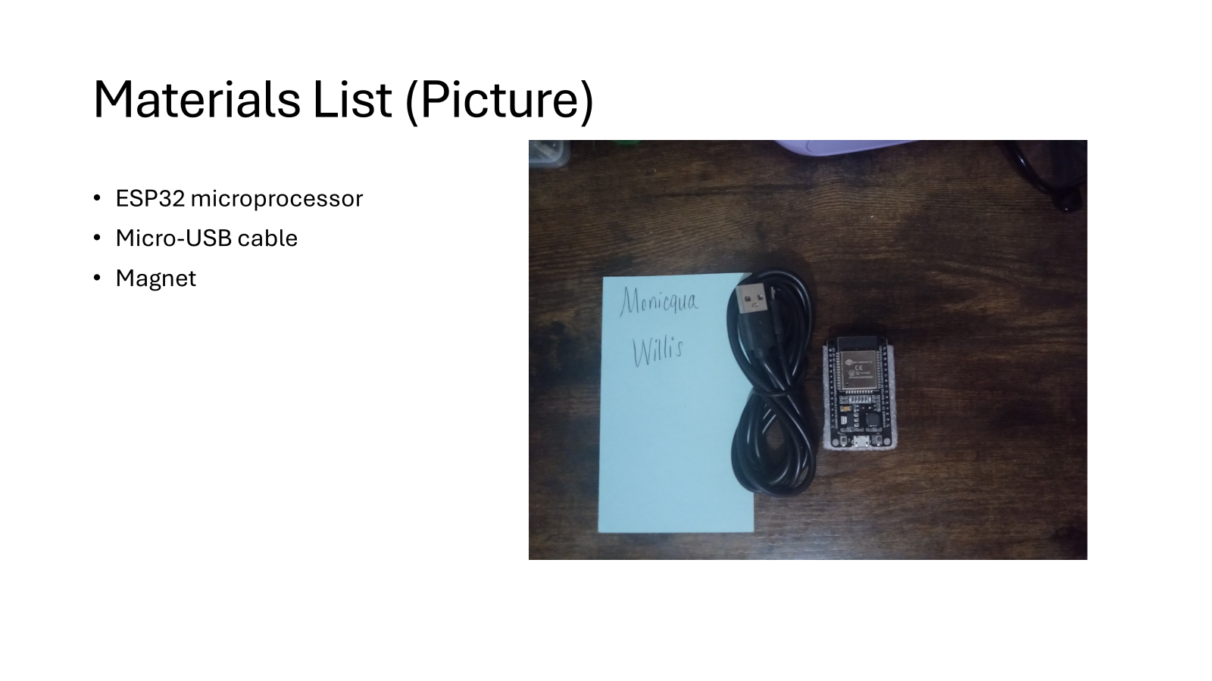

Slide 7
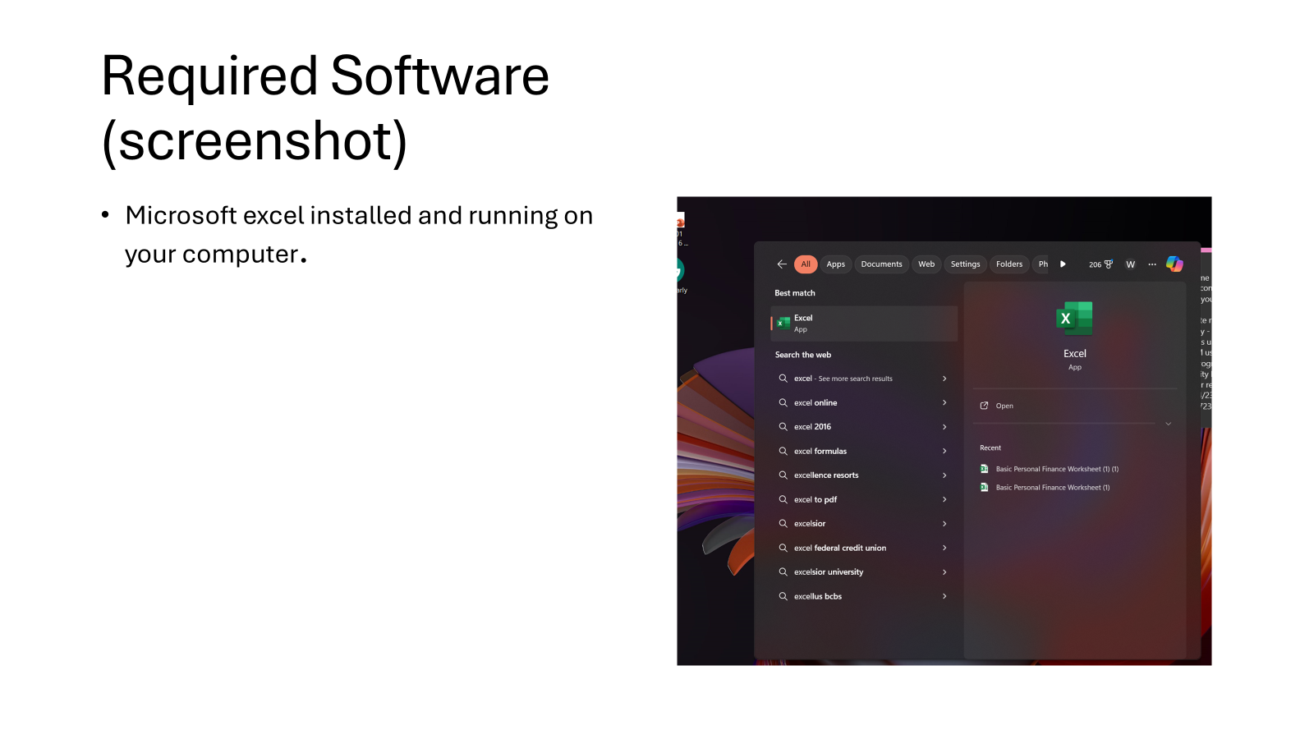

Slide 8
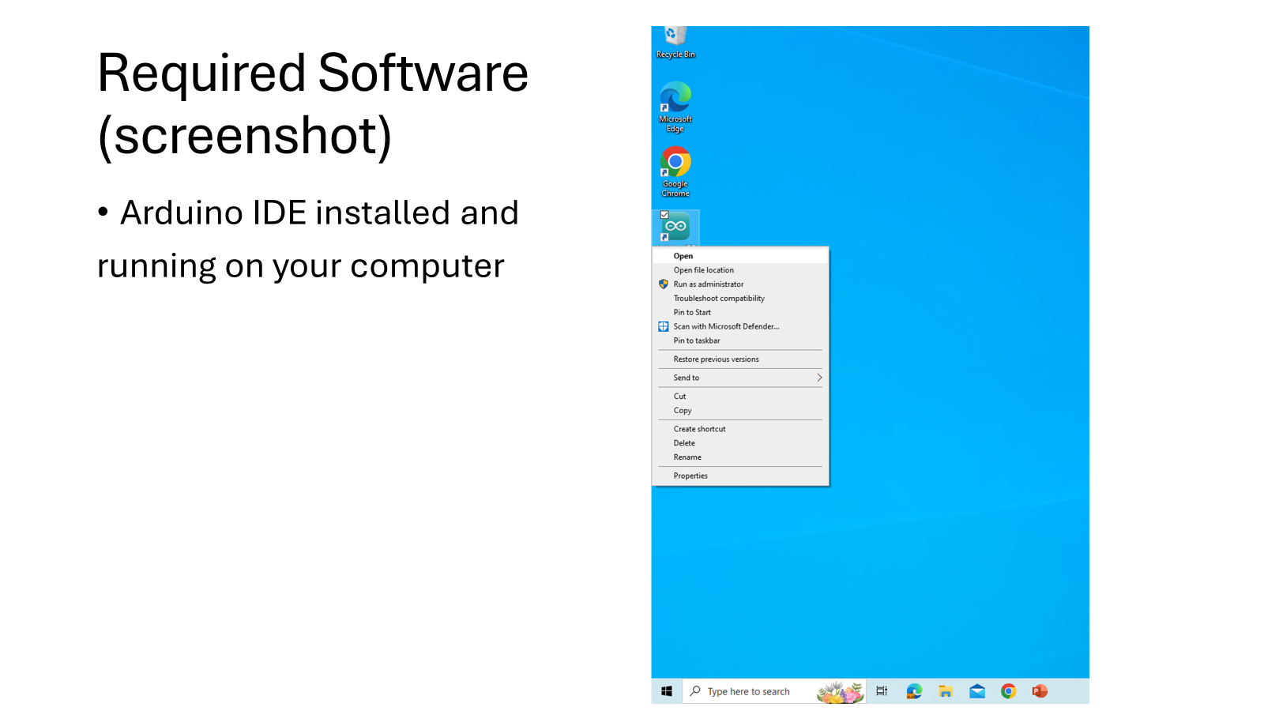

Slide 9
PRECISION OF ULTRASONIC SENSOR
The ultrasonic sensor is an electronic device with two transducers that detects an object within its range. Determining the precision of the data-gathering sensor is essential in experiments, as sensors often drift over time and give incorrect readings.

Slide 10
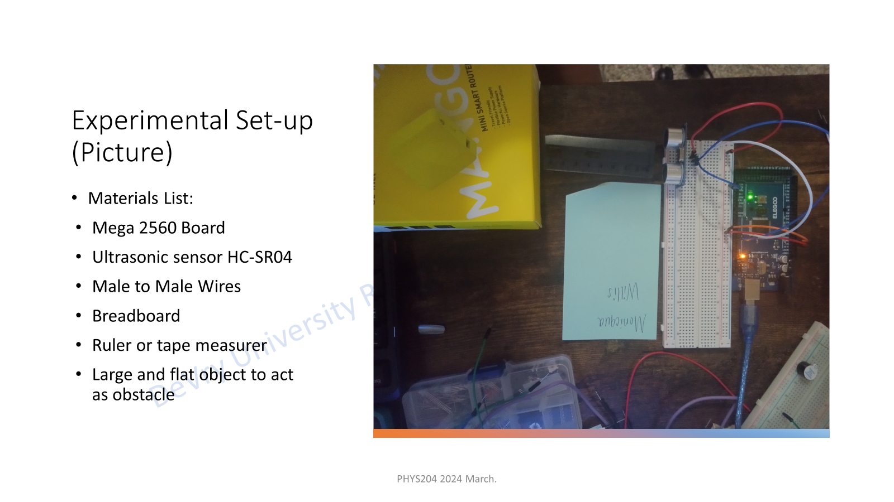
EXPERIMENTAL SETUP MATERIALS LIST

Slide 11
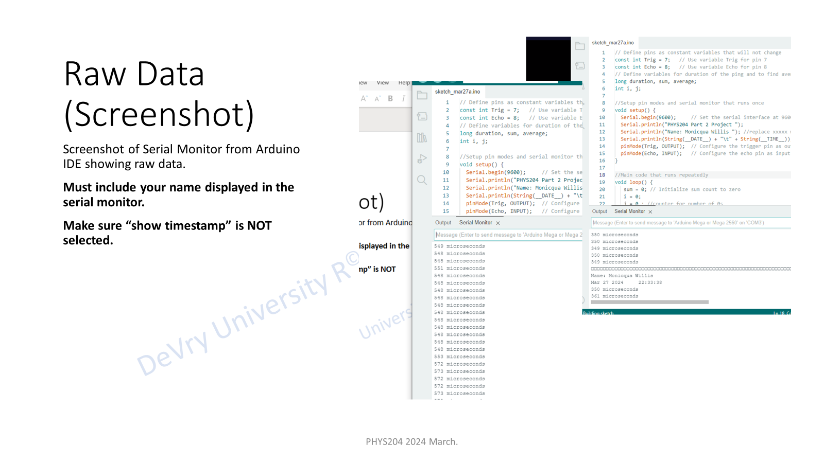

Slide 12
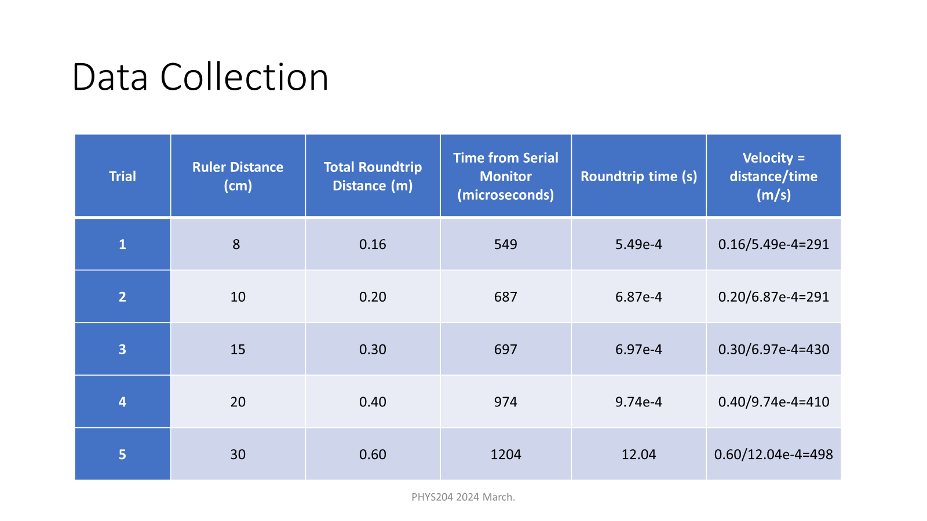

Slide 13
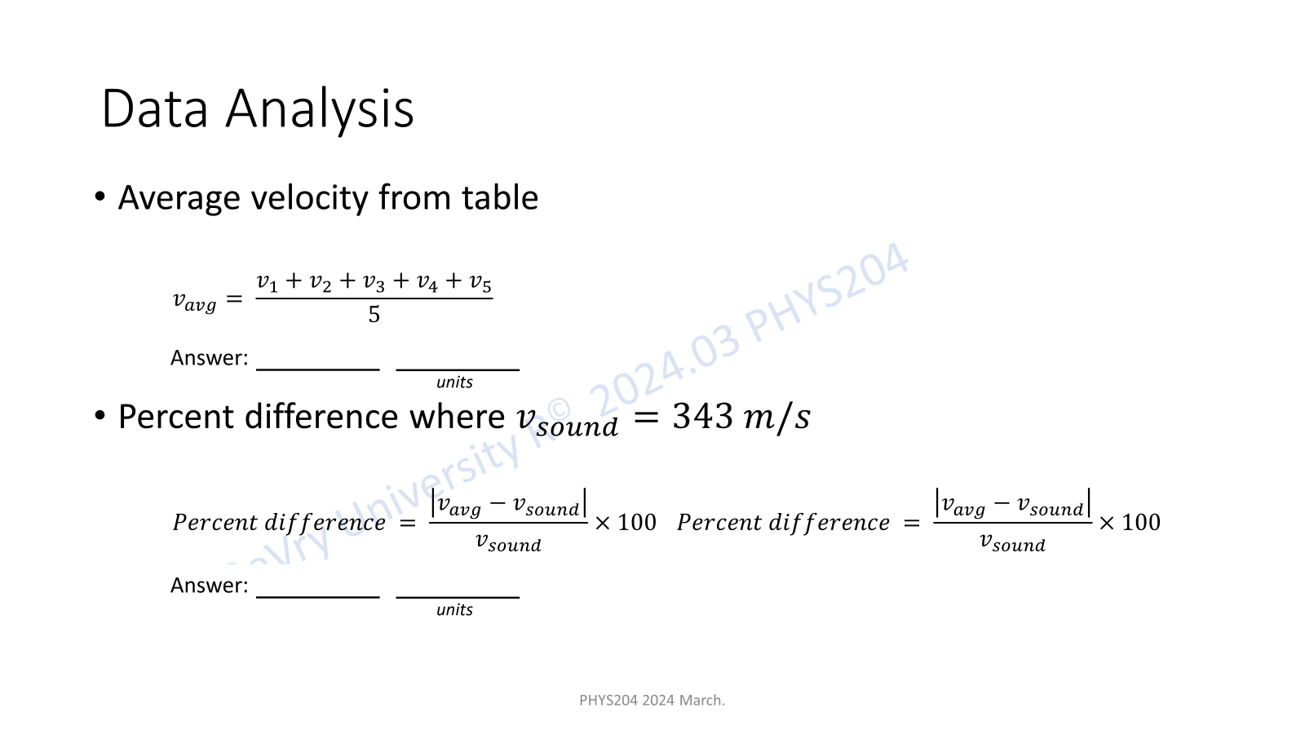

Slide 14
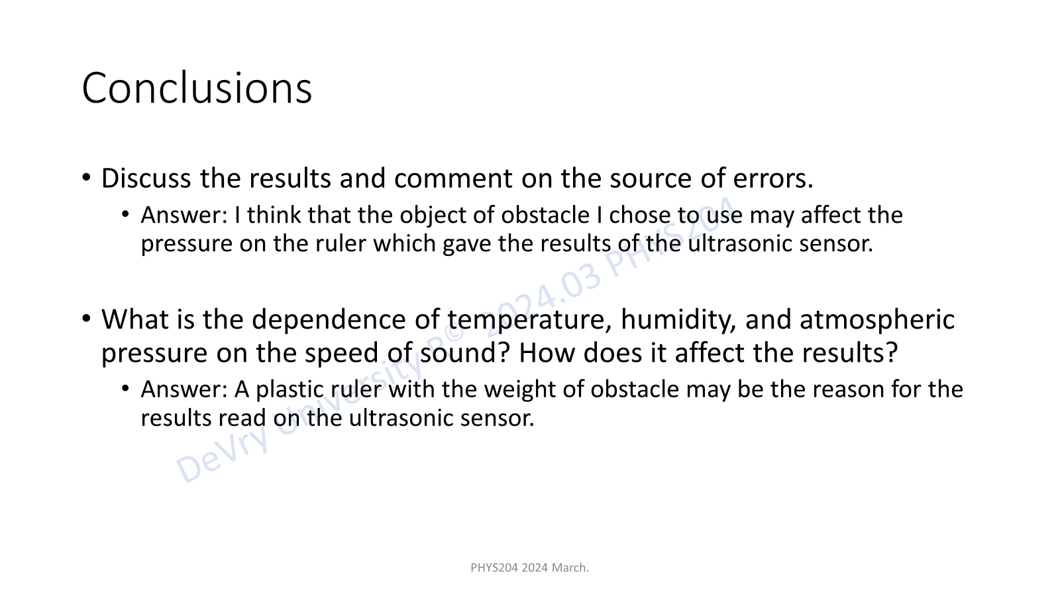

Slide 15
SKILLS GAINED DURING THIS EXPERIMENT
The skills gained in this experience were to read data in Excel, in turn developing technical, computational, and communication skills.

Slide 16
Free fall motion
In the previous slide, the Ultrasonic sensor was determined. The sensor is used to determine the gravitational acceleration of a free-falling object. This data will be used in the next part to investigate the conservation of energy during the fall.

Slide 17
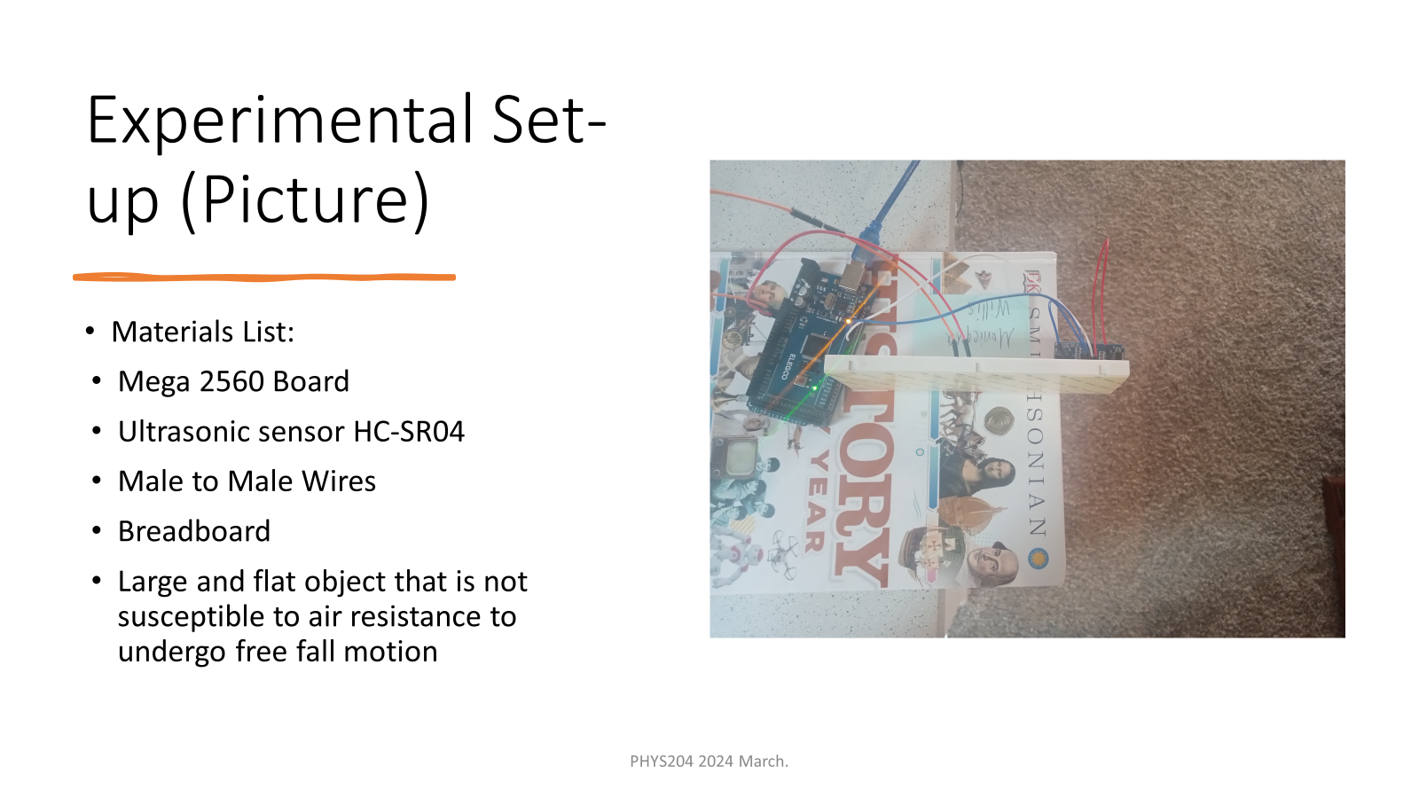

Slide 18
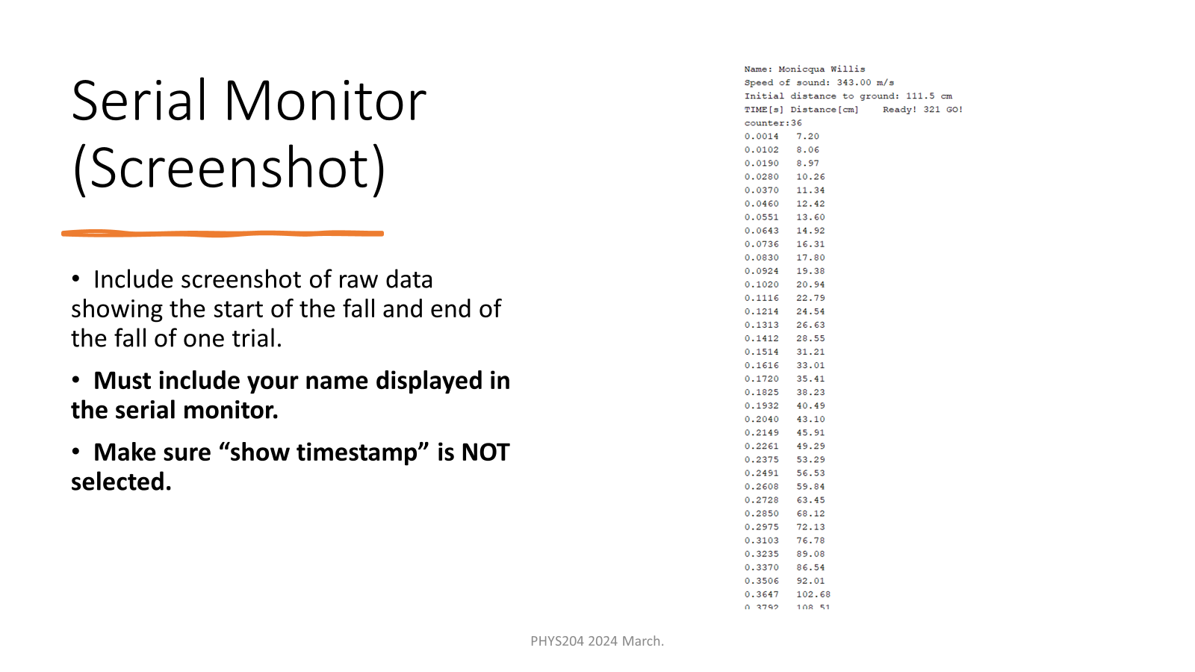

Slide 19
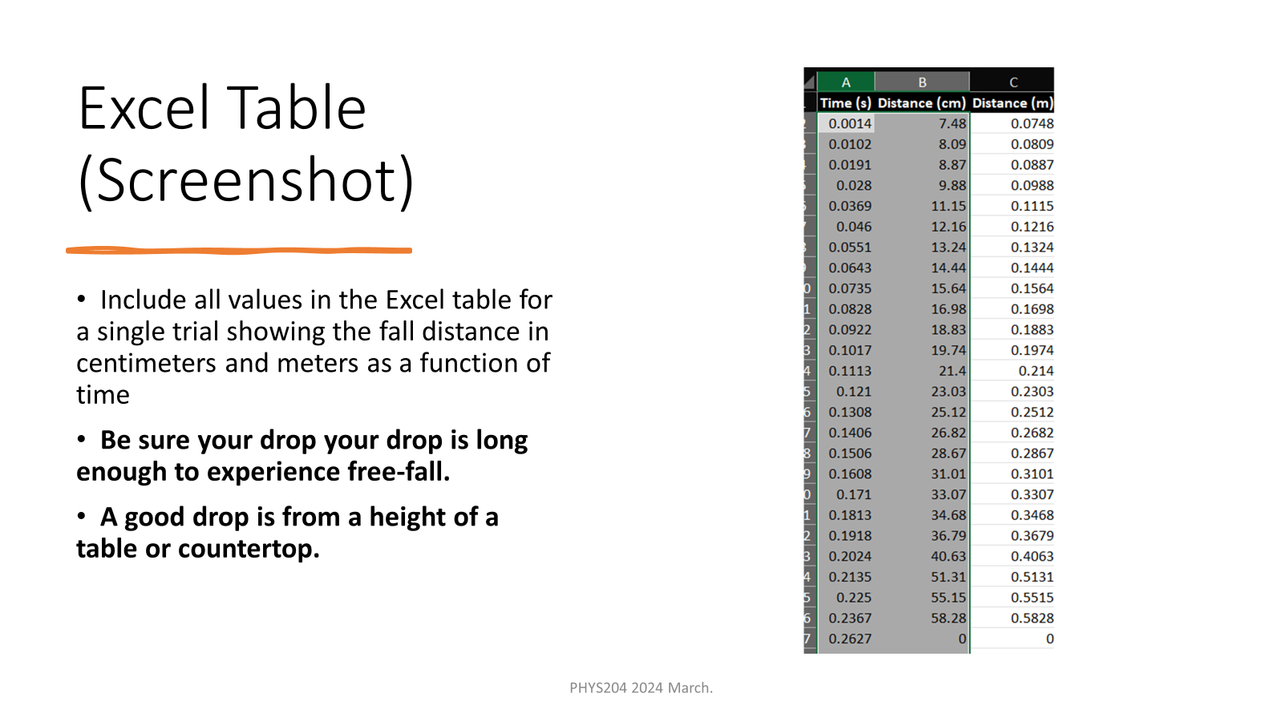

Slide 20
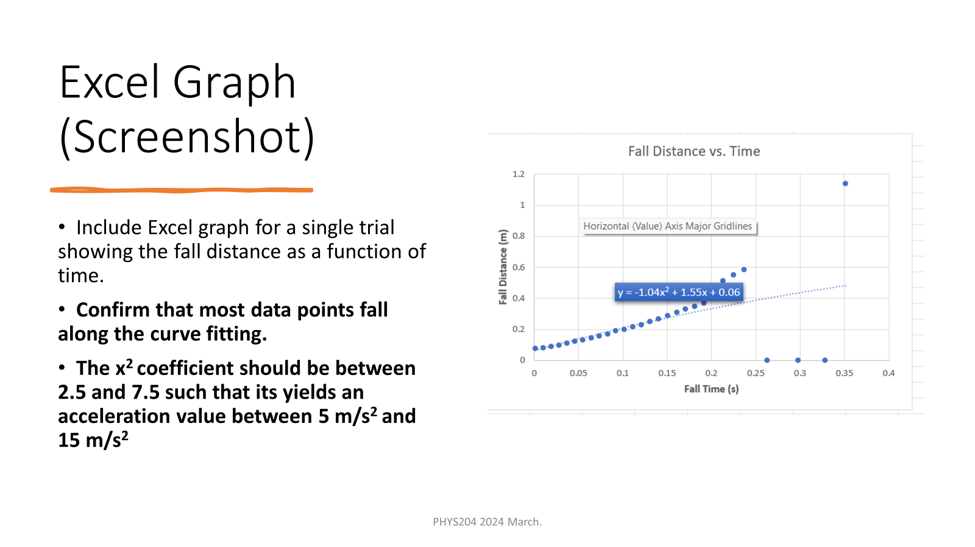

Slide 21
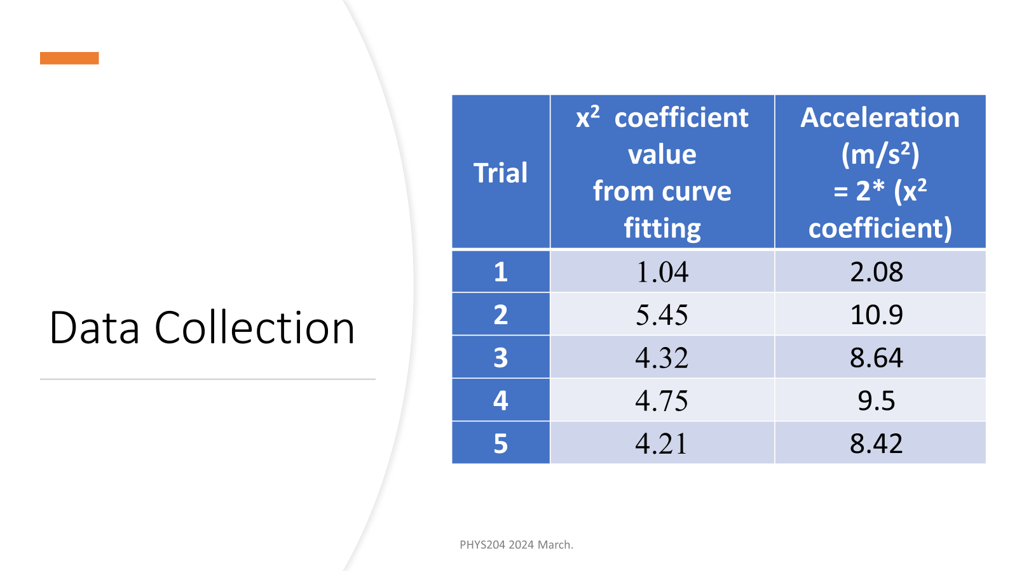

Slide 22
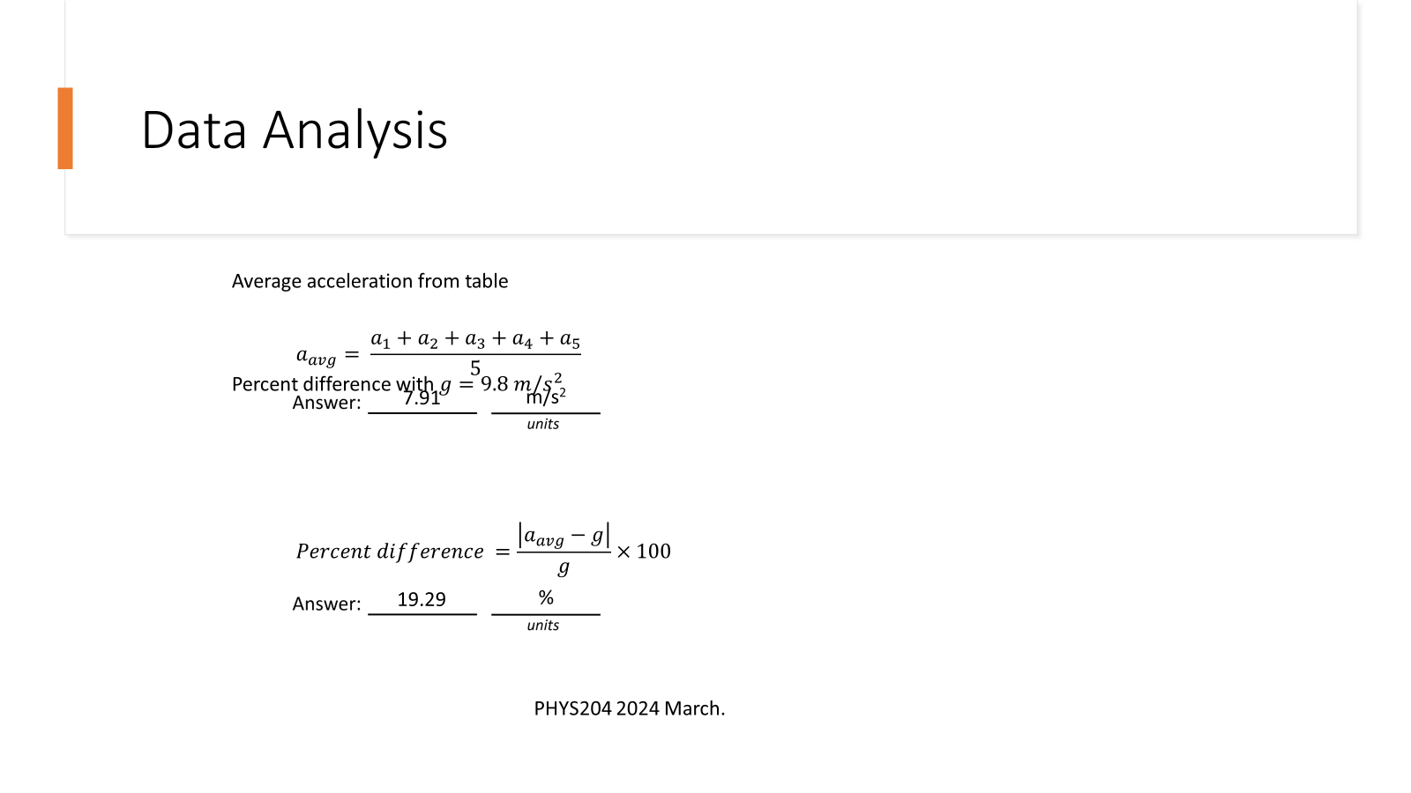

Slide 23
Project Challenges
The project involves dealing with a range of sensors and would require a good understanding of hardware. Additionally, the object in free fall motion indicates that it tends to move slightly, and thus, it would be necessary to take smaller time increments into account when analyzing its behavior.

Slide 24
SKILLS OBTAINED
The project’s development process includes critical thinking, hardware setup, and programming.
This project demands critical thinking in hardware setup and programming, covering multiple aspects of IoT that effectively prepare for a successful career in technology.

Slide 25
Future concluding remarks
Physics assists us in understanding the universe at various scales, ranging from subatomic to cosmological.

Slide 26
This project utilized everyday household items and simple experiments to gain a better understanding of the natural laws that govern our world of physics.

